Slide 1
ȘCOALA GIMNAZIALĂ NR 13 TIMIȘOARA
A European School

Slide 2
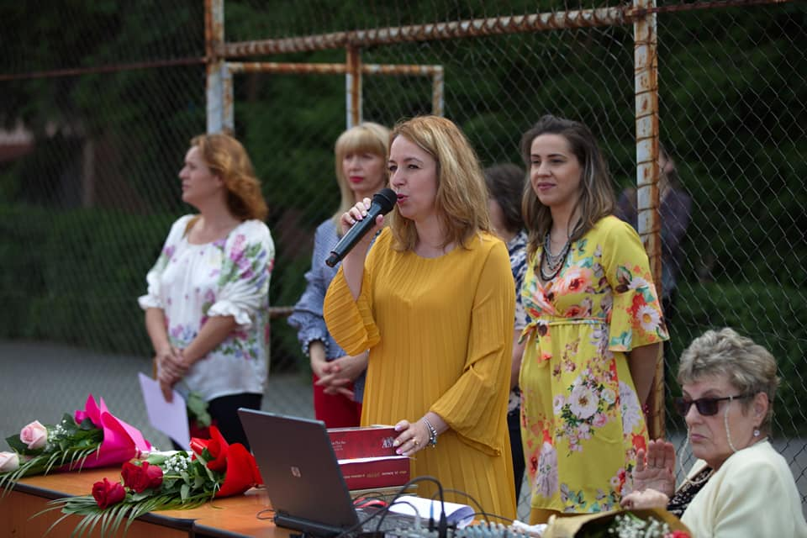
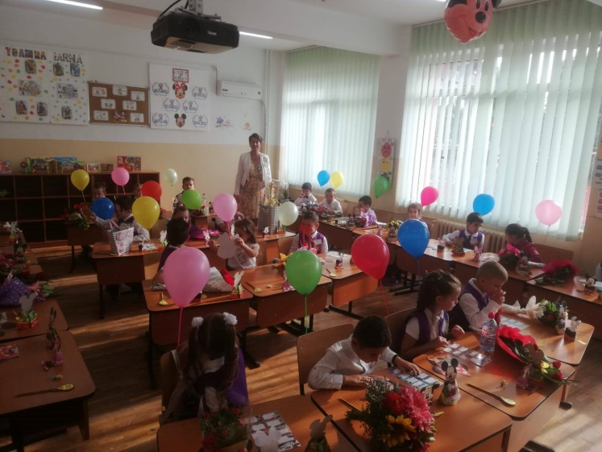
Secondary School no 13 from Timisoara is a representative institution for the state educational system of Timis County, one that has developed a stimulating educational climate, leading to the highest educational performances of its students. Our school prides itself in preparing its students for life, so that they would be able to solve problems and carry on professional and social duties, in offering equal chances to all students through integration, in treating every student according to their needs, character and development.

Slide 3
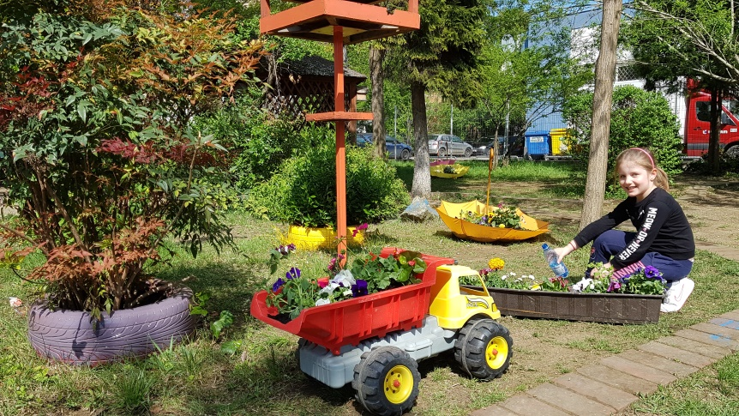
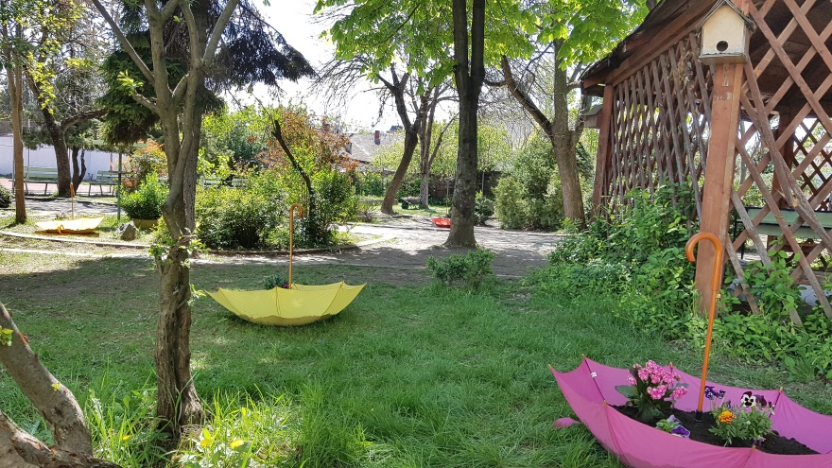
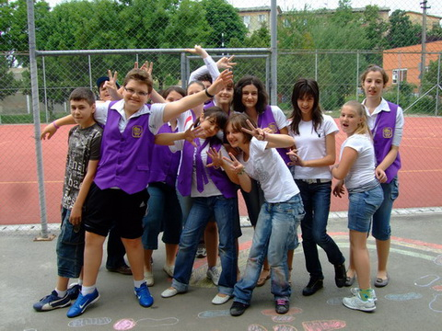
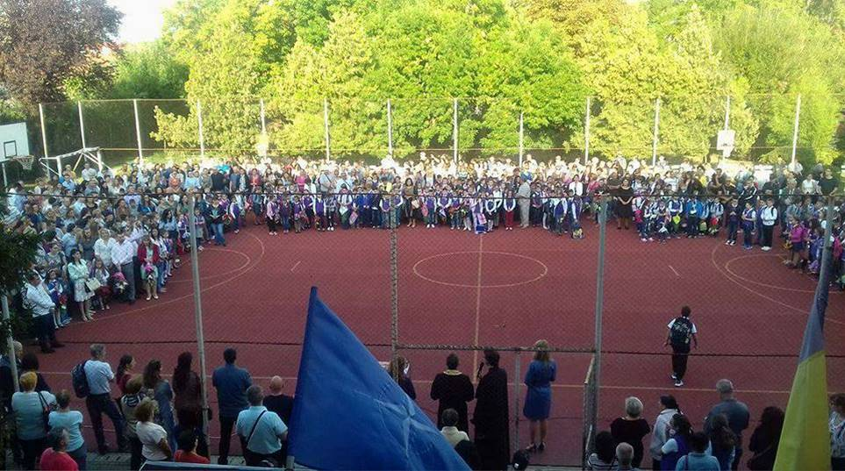

Slide 4
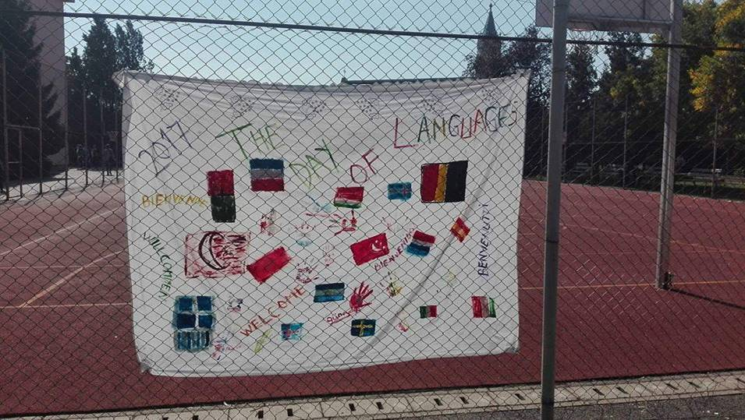
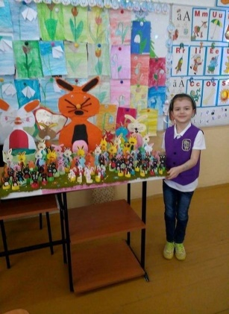
Our school includes primary and secondary education with three classes per level, and was built in the 1960s. The school is hosted in a two-floor builinding with 12 classrooms, 2 laboratories, 2 ICT rooms, 6 cabinets, a workroom, 4 offices, a sports hall, a medical office, 3 restrooms and 8 additional rooms. Also worth noting is that Secondary School no 13 is one of the few in Timisoara that offers German as a second language. Student exhibitions of drawings, posters, leaflets (among which those that focus on the 1st of December, Halloween, Christmas, Thanksgiving, Easter, Fasching, Comics, Green projects, The city of the future or spring), as well as going to the theatre, films, and art exhibitions are believed to play an important part in the development of students also. Public readings and meetings with writers organized at school are also meant to raise the students’ interest in reading and culture, and offer them an alternative to using their free time in their best interest.

Slide 5
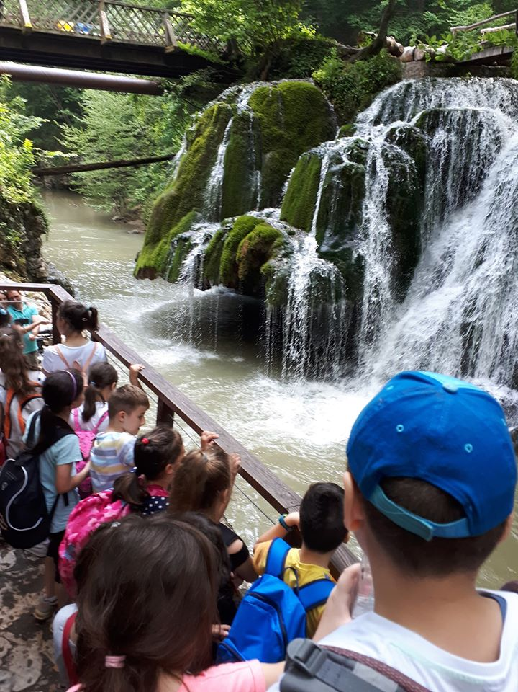
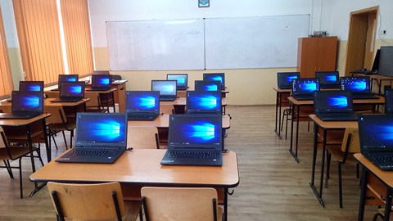
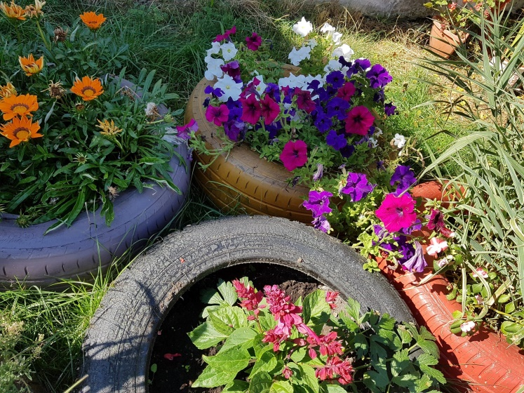
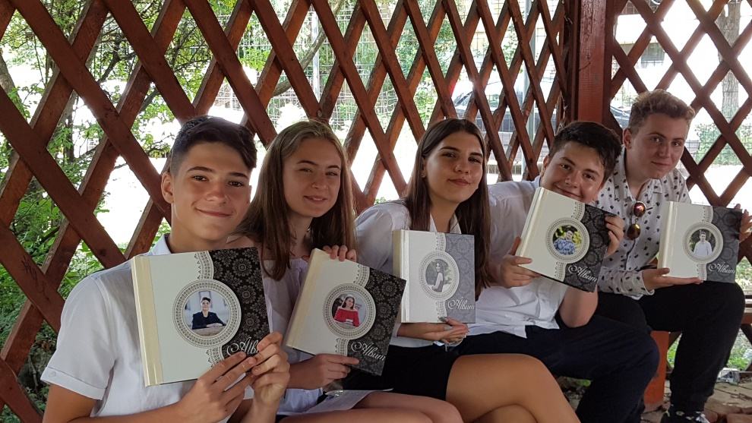

Slide 6
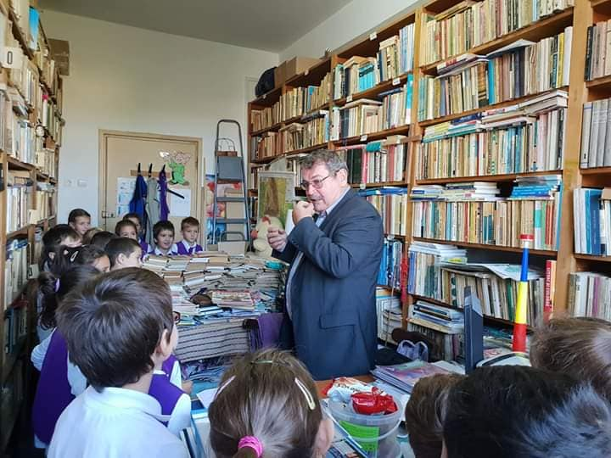
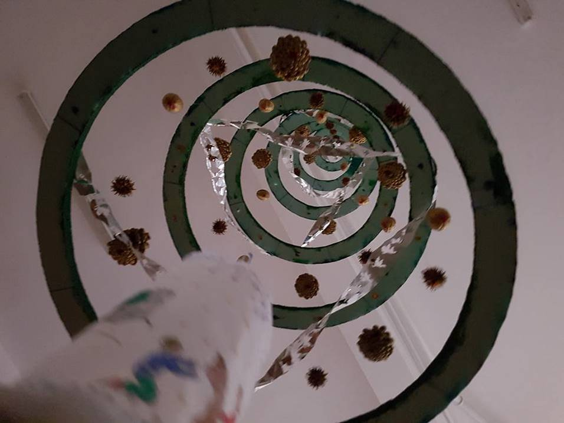
The classrooms
60 square metres, very bright
equipped with air conditioning, new desks and chairs, drawers, shelves, whiteboards, and projectors
most of them also have a computer, printing and copying machines, and some an interactive whiteboard.
The school also provides a small room for the library and a reading corner, with dictionaries, workbooks, important titles from the national curriculum, national and international literature for all ages, science, technology and many others.

Slide 7
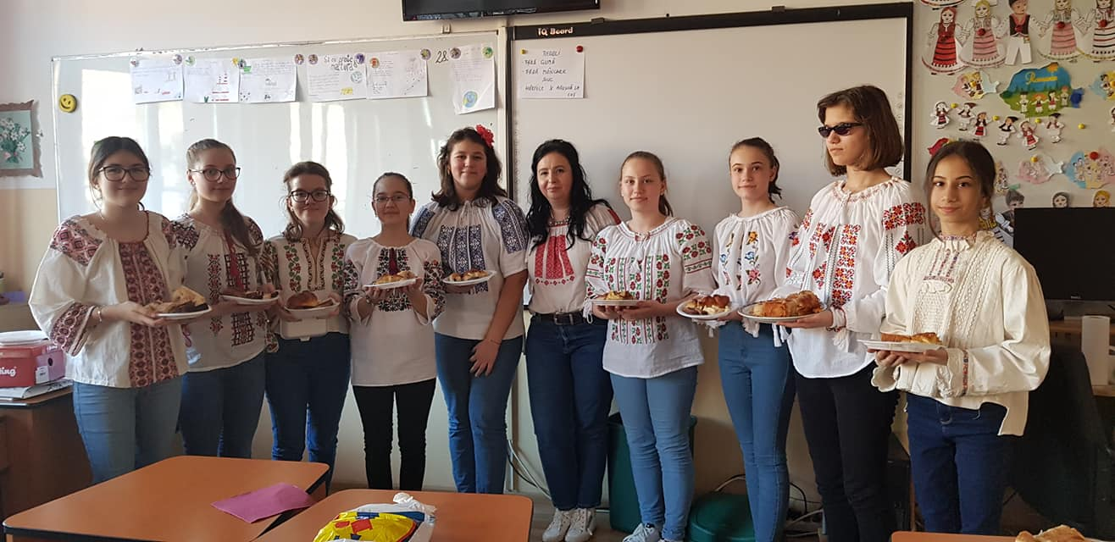
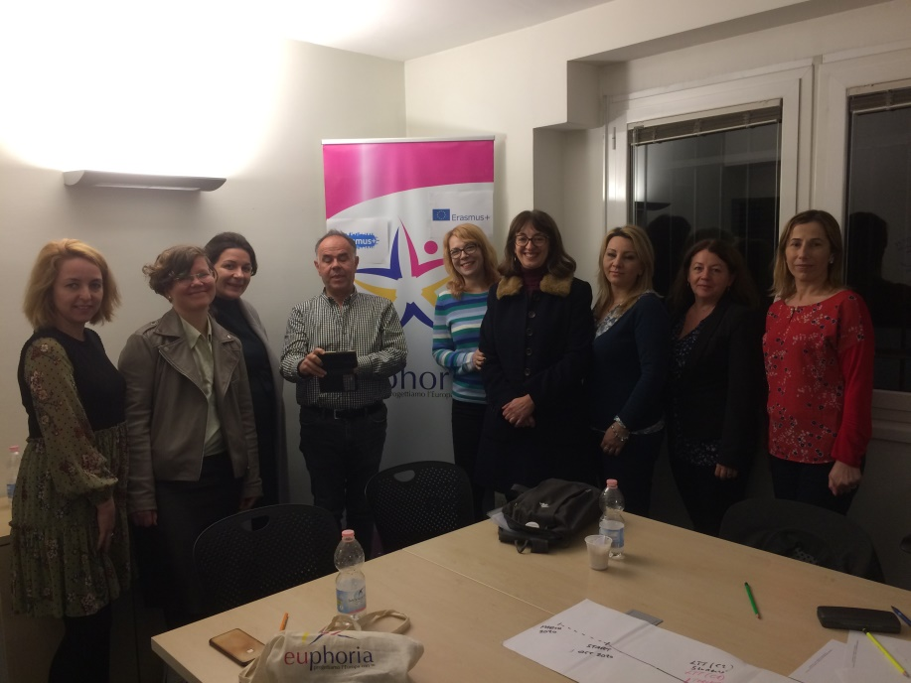
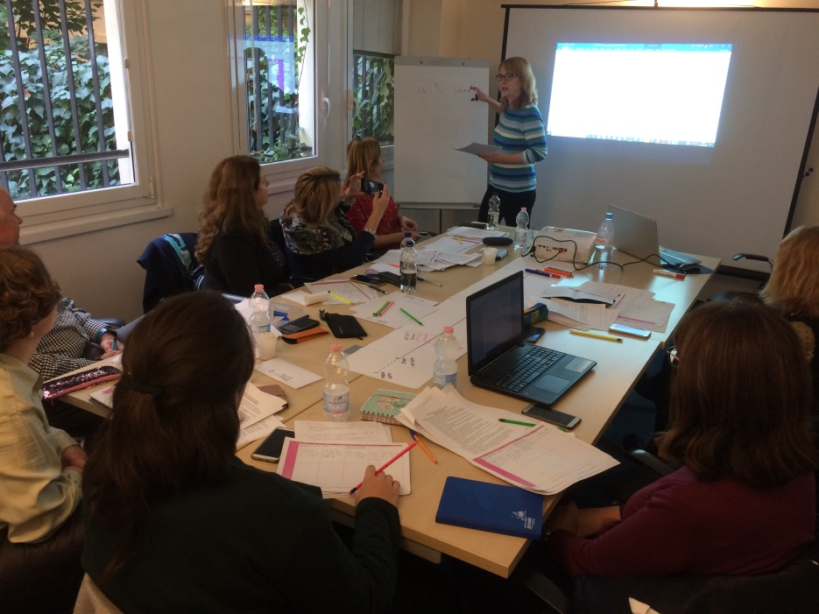

Slide 8
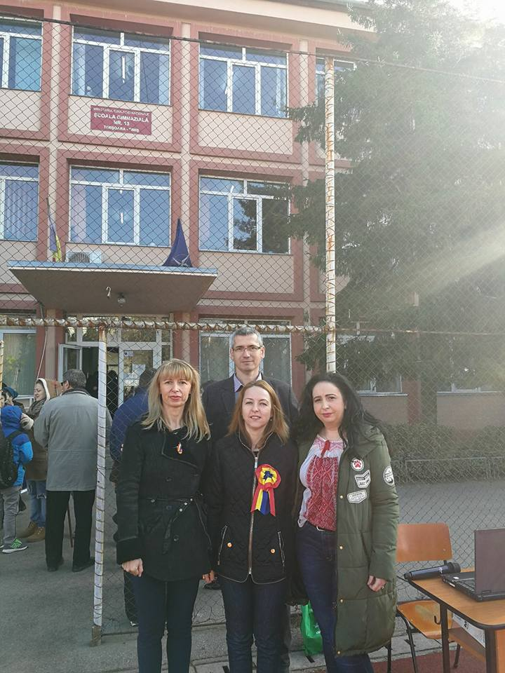
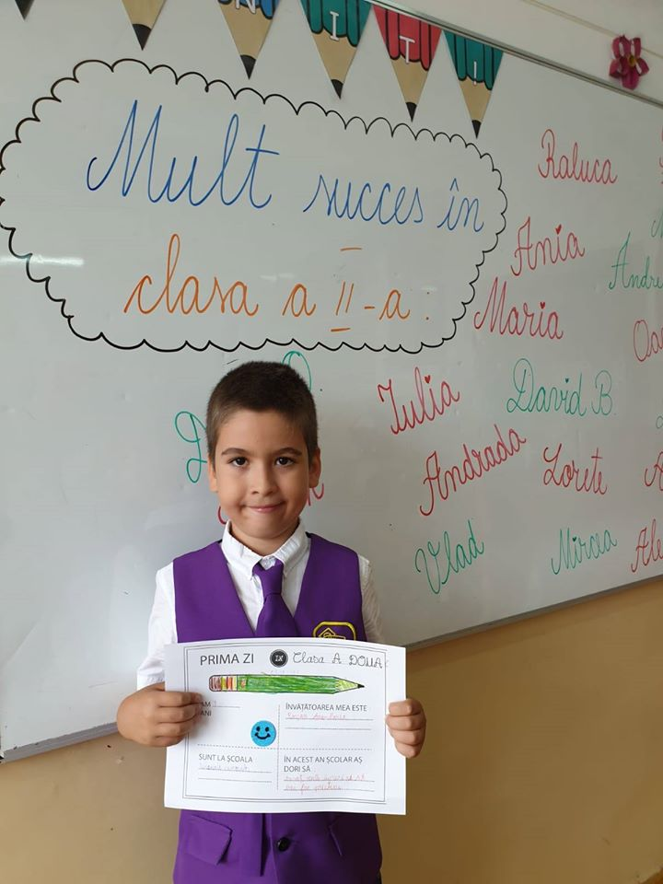
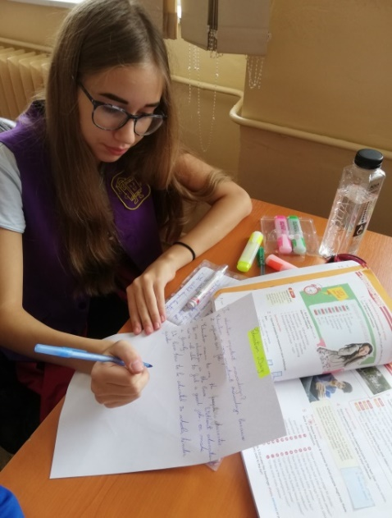
The school has had throughout the years numerous projects (Plein Air, Education without frontiers, Tolerance vs Violence, My child – My priority, Erntedankfest - Ziua Recoltei, Saint Martin, Oseti prirodu with Serbia, Christmas Fair, ECO13, The Magic of Christmas, Eco Nature, Customs and Traditions at Home and Abroad, to name only a few), and some of the best results in the county at school competitions and national examinations. The quality of the teaching process is also visible in the final results at the end of the school year. In 2017-2018, for instance, 99,73% of the primary school students graduated, whereas for the secondary school students, the figures show 99,28%.

Slide 9
